Slide 1
ساختمان داده‌ها
پیمایش گراف
Notes:
Give qualifications of instructors:
DAP
teaching computer architecture at Berkeley since 1977
Co-athor of textbook used in class
Best known for being one of pioneers of RISC
currently author of article on future of microprocessors in SciAm Sept 1995
RY
took 152 as student, TAed 152,instructor in 152
undergrad and grad work at Berkeley
joined NextGen to design fact 80x86 microprocessors
one of architects of UltraSPARC fastest SPARC mper shipping this Fall

Slide 2
مرور
مشکل: چگونه تمام نودهای گراف را مشاهده کنیم؟
جستجوی اول عمق
  دنبال کردن مسیرهای بین راسها.
جستجوی اول سطح
  دیدن تمام همسایه های نود.
الگوریتمهای خوبی برای پیمایش وجود دارند.
کاربردهای مفید زیادی وجود دارند.

Slide 3
پیمایش گراف
تمام شهرهایی که از فرودگاه هارتفورد قابل دسترسی هستند را پیدا کنید.
CHI
Hartford
SF
NYC
LA
W. DC

Slide 4
پیمایش گراف
تمام نودهای که از u قابل دسترسی هستند را پیدا کنید.
هر نود دارای یک پرچم است که نشان می دهد نود دیده شده است یا خیر.
تمام نودها را ببینید.
بعضی نودها ممکن است به بقیه متصل نباشند.

Slide 5
دموی الگوریتم پیمایش
قدم اول: هارتفورد
  پیدا کردن همسایه های هارتفورد.
  { Hartford, NYC, CHI }
CHI
SF
Hartford
NYC
LA
W. DC

Slide 6
ادامه ی دموی الگوریتم پیمایش
قدم دوم: { Hartford, NYC, CHI }
  پیداکردن همسایه های NYC, CHI
  { Hartford, NYC, CHI, LA, SF }
CHI
SF
Hartford
NYC
LA
W. DC

Slide 7
ادامه ی دموی الگوریتم پیمایش
قدم سوم: {Hartford, NYC, CHI, LA, SF }
  پیدا کردن همسایه های LA, SF
  هیچ همسایه ی دیگری وجود ندارد.
CHI
SF
Hartford
NYC
LA
W. DC

Slide 8
ادامه ی دموی الگوریتم پیمایش
و در نهایت جواب را پیدا می کنیم.
  {Hartford, NYC, CHI, LA, SF }
CHI
SF
Hartford
NYC
LA
W. DC

Slide 9
الگوریتم پیمایش گراف
Mark all nodes as unvisited
Pick a starting vertex u, add u to probing list
While ( probing list is not empty)
{
Remove a node v from probing list
Mark node v as visited
For each neighbor w of v, if w is unvisited, add w to the probing list
}

Slide 10
پیمایش گراف
گره ی شروع
  باید یک گره ی اختیاری را انتخاب کنیم و پیمایش را از آنجا شروع کنیم.
پیمایش اول عمق
  یالها را آنقدر دنبال کنید تا دچار بن بست شوید. سپس به عقب برگردید و از آخرین نقطه ی انشعاب ادامه دهید.
پیمایش اول سطح
  یکی از گره ها را ببینید. سپس همسایه های آنرا ببینید. سپس گره های دو سطح پایینتر و ....

Slide 11
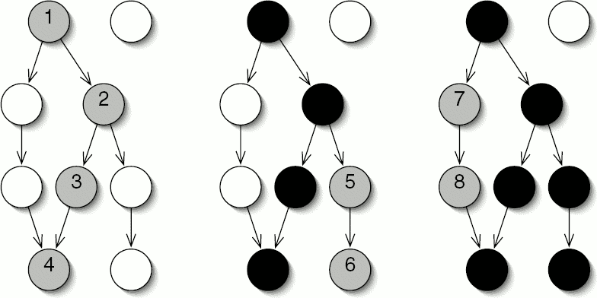
پیمایش گراف
پیمایش اول عمق
Start
Note that all 8 nodes are visited eventually

Slide 12
پیمایش اول عمق
لیست آزمایشی را با پشته پیاده می‌کنیم.
مثال:
  A’s neighbor: B, C, E
  B’s neighbor: A, C, F
  C’s neighbor: A, B, D
  D’s neighbor: E, C, F
  E’s neighbor: A, D
  F’s neighbor: B, D
  start from vertex A
A
B
E
C
F
D

Slide 13
پیمایش اول عمق
  A’s neighbor: B C E
  B’s neighbor: A C F
  C’s neighbor: A B D
  D’s neighbor: E C F
  E’s neighbor: A D
  F’s neighbor: B D
A
B
E
C
F
D
حالت اولیه
  Visited Vertices { }
  Probing Vertices { A }
  Unvisited Vertices { A, B, C, D, E, F }
پشته
A

Slide 14
Depth First Traversal (Cont)
  A’s neighbor: B C E
  B’s neighbor: A C F
  C’s neighbor: A B D
  D’s neighbor: E C F
  E’s neighbor: A D
  F’s neighbor: B D
A
B
E
C
F
D
Peek a vertex from stack, it is A, mark it as visited
Find A’s first unvisited neighbor, push it into stack
  Visited Vertices { A }
  Probing vertices { A, B }
  Unvisited Vertices { B, C, D, E, F }
B
A
A
stack

Slide 15
Depth First Traversal (Cont)
  A’s neighbor: B C E
  B’s neighbor: A C F
  C’s neighbor: A B D
  D’s neighbor: E C F
  E’s neighbor: A D
  F’s neighbor: B D
A
B
E
C
F
D
Peek a vertex from stack, it is B, mark it as visited
Find B’s first unvisited neighbor, push it in stack
  Visited Vertices { A, B }
  Probing Vertices { A, B, C }
  Unvisited Vertices { C, D, E, F }
C
B
B
A
A
stack

Slide 16
Depth First Traversal (Cont)
  A’s neighbor: B C E
  B’s neighbor: A C F
  C’s neighbor: A B D
  D’s neighbor: E C F
  E’s neighbor: A D
  F’s neighbor: B D
A
B
E
C
F
D
Peek a vertex from stack, it is C, mark it as visited
Find C’s first unvisited neighbor, push it in stack
  Visited Vertices { A, B, C }
  Probing Vertices { A, B, C, D }
  Unvisited Vertices { D, E, F }
D
C
C
B
B
A
A
stack

Slide 17
Depth First Traversal (Cont)
  A’s neighbor: B C E
  B’s neighbor: A C F
  C’s neighbor: A B D
  D’s neighbor: E C F
  E’s neighbor: A D
  F’s neighbor: B D
A
B
E
C
F
D
Peek a vertex from stack, it is D, mark it as visited
Find D’s first unvisited neighbor, push it in stack
  Visited Vertices { A, B, C, D }
  Probing Vertices { A, B, C, D, E }
  Unvisited Vertices { E, F }
E
D
D
C
C
B
B
A
A
stack

Slide 18
Depth First Traversal (Cont)
  A’s neighbor: B C E
  B’s neighbor: A C F
  C’s neighbor: A B D
  D’s neighbor: E C F
  E’s neighbor: A D
  F’s neighbor: B D
A
B
E
C
F
D
Peek a vertex from stack, it is E, mark it as visited
Find E’s first unvisited neighbor, no vertex found, Pop E
  Visited Vertices { A, B, C, D, E }
  Probing Vertices { A, B, C, D }
  Unvisited Vertices { F }
E
D
D
C
C
B
B
A
A
stack

Slide 19
Depth First Traversal (Cont)
  A’s neighbor: B C E
  B’s neighbor: A C F
  C’s neighbor: A B D
  D’s neighbor: E C F
  E’s neighbor: A D
  F’s neighbor: B D
A
B
E
C
F
D
Peek a vertex from stack, it is D, mark it as visited
Find D’s first unvisited neighbor, push it in stack
  Visited Vertices { A, B, C, D, E }
  Probing Vertices { A, B, C, D, F}
  Unvisited Vertices { F }
F
D
D
C
C
B
B
A
A
stack

Slide 20
Depth First Traversal (Cont)
  A’s neighbor: B C E
  B’s neighbor: A C F
  C’s neighbor: A B D
  D’s neighbor: E C F
  E’s neighbor: A D
  F’s neighbor: B D
A
B
E
C
F
D
Peek a vertex from stack, it is F, mark it as visited
Find F’s first unvisited neighbor, no vertex found, Pop F
  Visited Vertices { A, B, C, D, E, F }
  Probing Vertices { A, B, C, D}
  Unvisited Vertices { }
F
D
D
C
C
B
B
A
A
stack

Slide 21
Depth First Traversal (Cont)
  A’s neighbor: B C E
  B’s neighbor: A C F
  C’s neighbor: A B D
  D’s neighbor: E C F
  E’s neighbor: A D
  F’s neighbor: B D
A
B
E
C
F
D
Peek a vertex from stack, it is D, mark it as visited
Find D’s first unvisited neighbor, no vertex found, Pop D
  Visited Vertices { A, B, C, D, E, F }
  Probing Vertices { A, B, C }
  Unvisited Vertices { }
D
C
C
B
B
A
A
stack

Slide 22
Depth First Traversal (Cont)
  A’s neighbor: B C E
  B’s neighbor: A C F
  C’s neighbor: A B D
  D’s neighbor: E C F
  E’s neighbor: A D
  F’s neighbor: B D
A
B
E
C
F
D
Peek a vertex from stack, it is C, mark it as visited
Find C’s first unvisited neighbor, no vertex found, Pop C
  Visited Vertices { A, B, C, D, E, F }
  Probing Vertices { A, B }
  Unvisited Vertices { }
C
B
B
A
A
stack

Slide 23
Depth First Traversal (Cont)
  A’s neighbor: B C E
  B’s neighbor: A C F
  C’s neighbor: A B D
  D’s neighbor: E C F
  E’s neighbor: A D
  F’s neighbor: B D
A
B
E
C
F
D
Peek a vertex from stack, it is B, mark it as visited
Find B’s first unvisited neighbor, no vertex found, Pop B
  Visited Vertices { A, B, C, D, E, F }
  Probing Vertices { A }
  Unvisited Vertices { }
B
A
A
stack

Slide 24
Depth First Traversal (Cont)
  A’s neighbor: B C E
  B’s neighbor: A C F
  C’s neighbor: A B D
  D’s neighbor: E C F
  E’s neighbor: A D
  F’s neighbor: B D
A
B
E
C
F
D
Peek a vertex from stack, it is A, mark it as visited
Find A’s first unvisited neighbor, no vertex found, Pop A
  Visited Vertices { A, B, C, D, E, F }
  Probing Vertices { }
  Unvisited Vertices { }
A
stack

Slide 25
Depth First Traversal (Cont)
  A’s neighbor: B C E
  B’s neighbor: A C F
  C’s neighbor: A B D
  D’s neighbor: E C F
  E’s neighbor: A D
  F’s neighbor: B D
A
B
E
C
F
D
Now probing list is empty
End of Depth First Traversal
  Visited Vertices { A, B, C, D, E, F }
  Probing Vertices { }
  Unvisited Vertices { }
stack

Slide 26
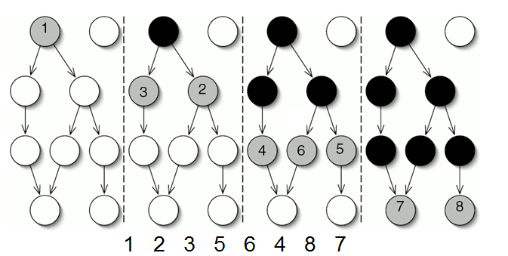
پیمایش گراف
پیمایش اول سطح
Start

Slide 27
Breadth First Traversal
Probing List is implemented as queue (FIFO)
Example
  A’s neighbor: B C E
  B’s neighbor: A C F
  C’s neighbor: A B D
  D’s neighbor: E C F
  E’s neighbor: A D
  F’s neighbor: B D
  start from vertex A
A
B
E
C
F
D

Slide 28
Breadth First Traversal (Cont)
  A’s neighbor: B C E
  B’s neighbor: A C F
  C’s neighbor: A B D
  D’s neighbor: E C F
  E’s neighbor: A D
  F’s neighbor: B D
A
B
E
C
F
D
Initial State
  Visited Vertices { }
  Probing Vertices { A }
  Unvisited Vertices { A, B, C, D, E, F }
A
queue

Slide 29
Breadth First Traversal (Cont)
  A’s neighbor: B C E
  B’s neighbor: A C F
  C’s neighbor: A B D
  D’s neighbor: E C F
  E’s neighbor: A D
  F’s neighbor: B D
A
B
E
C
F
D
Delete first vertex from queue, it is A, mark it as visited
Find A’s all unvisited neighbors, mark them as visited, put them into queue
  Visited Vertices { A, B, C, E }
  Probing Vertices { B, C, E }
  Unvisited Vertices { D, F }
A
B
C
E
queue

Slide 30
Breadth First Traversal (Cont)
  A’s neighbor: B C E
  B’s neighbor: A C F
  C’s neighbor: A B D
  D’s neighbor: E C F
  E’s neighbor: A D
  F’s neighbor: B D
A
B
E
C
F
D
Delete first vertex from queue, it is B, mark it as visited
Find B’s all unvisited neighbors, mark them as visited, put them into queue
  Visited Vertices { A, B, C, E, F }
  Probing Vertices { C, E, F }
  Unvisited Vertices { D }
B
C
E
C
E
F
queue

Slide 31
Breadth First Traversal (Cont)
  A’s neighbor: B C E
  B’s neighbor: A C F
  C’s neighbor: A B D
  D’s neighbor: E C F
  E’s neighbor: A D
  F’s neighbor: B D
A
B
E
C
F
D
Delete first vertex from queue, it is C, mark it as visited
Find C’s all unvisited neighbors, mark them as visited, put them into queue
  Visited Vertices { A, B, C, E, F, D }
  Probing Vertices { E, F, D }
  Unvisited Vertices { }
C
E
F
E
F
D
queue

Slide 32
Breadth First Traversal (Cont)
  A’s neighbor: B C E
  B’s neighbor: A C F
  C’s neighbor: A B D
  D’s neighbor: E C F
  E’s neighbor: A D
  F’s neighbor: B D
A
B
E
C
F
D
Delete first vertex from queue, it is E, mark it as visited
Find E’s all unvisited neighbors, no vertex found
  Visited Vertices { A, B, C, E, F, D }
  Probing Vertices { F, D }
  Unvisited Vertices { }
E
F
D
F
D
queue

Slide 33
Breadth First Traversal (Cont)
  A’s neighbor: B C E
  B’s neighbor: A C F
  C’s neighbor: A B D
  D’s neighbor: E C F
  E’s neighbor: A D
  F’s neighbor: B D
A
B
E
C
F
D
Delete first vertex from queue, it is F, mark it as visited
Find F’s all unvisited neighbors, no vertex found
  Visited Vertices { A, B, C, E, F, D }
  Probing Vertices { D }
  Unvisited Vertices { }
F
D
D
queue

Slide 34
Breadth First Traversal (Cont)
  A’s neighbor: B C E
  B’s neighbor: A C F
  C’s neighbor: A B D
  D’s neighbor: E C F
  E’s neighbor: A D
  F’s neighbor: B D
A
B
E
C
F
D
Delete first vertex from queue, it is D, mark it as visited
Find D’s all unvisited neighbors, no vertex found
  Visited Vertices { A, B, C, E, F, D }
  Probing Vertices { }
  Unvisited Vertices { }
D
queue

Slide 35
Breadth First Traversal (Cont)
  A’s neighbor: B C E
  B’s neighbor: A C F
  C’s neighbor: A B D
  D’s neighbor: E C F
  E’s neighbor: A D
  F’s neighbor: B D
A
B
E
C
F
D
Now the queue is empty
End of Breadth First Traversal
  Visited Vertices { A, B, C, E, F, D }
  Probing Vertices { }
  Unvisited Vertices { }
queue

Slide 36
تفاوت بین اول سطح و اول عمق
پیمایش اول عمق (DFT)
  ترتیب: A, B, C, D, E, F
پیمایش اول سطح (BFT)
  ترتیب: A, B, C, E, F, D
A
B
E
C
F
D

Slide 37
پیچیدگی پیمایش گراف
ماتریس مجاورت
Cost: O(N*N) = O(N²)
لیست مجاورت
  برای هر نود v یک درجه وجود دارد.
  هزینه پیمایش برابر مجموع درجه ی نودها است. (2E)
  لذا پیمایش از درجه ی O(E) خواهد بود.

